Slide 1
Pointers

Slide 2
Pointer - Introduction
Pointer is a memory location or a variable which stores the memory address of another variable in memory.
Pointers are much more commonly used in C than in many other languages (such as BASIC, Pascal, and certainly Java, which has no pointers).

Slide 3
Common Uses of Pointers
Accessing array elements.
Passing arrays and strings to functions
Passing arguments to a function when the function needs to modify the original argument.
Obtaining memory from the system.
Creating data structures such as linked lists
.

Slide 4
Why Pointers?
It enables the access to a variable that is defined outside the function
Pointers reduce the length and complexity of a program.
They increase the execution speed
The use of a pointer array to character strings results in saving of data storage space in the memory

Slide 5
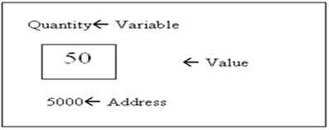
Concept
int Quantity = 50;
This statement instructs the system to find a location for the integer variable Quantity and puts the value 50 in that location.
Assume that system has chosen address location 5000 for Quantity

Slide 6
Concept
During execution of the program, the system always associates the name Quantity with the address 5000.
We may have access to the value 50 by using either the name of the variable Quantity or the address 5000.
Since memory addresses are simply numbers, they can be assigned to some variables which can be stored in memory, like any other variable.
To assign the address 5000 (the location of Quantity) to a variable p, we can write:
p =&Quantity;
Such variables that hold memory addresses are called Pointer Variables

Slide 7
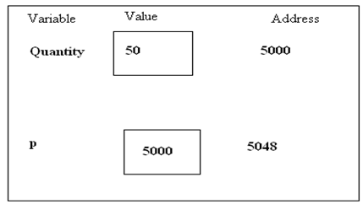
Concept
The operator & can be called as address of and can be used only with a simple variable or an array element.

Slide 8
Valid and Invalid cases
Invalid Cases:
&50 (pointing at constant)
int x[10];
&x (pointing at array name)
&(x + y) (pointing at expressions).
If x is an array, then expressions such as &x[0] and &x[i+3] are valid and represent the addresses of 0th and (i+3)th elements of x.

Slide 9
Declaring and Initializing Pointers
Declaration Syntax:
<datatype> *pt name;
This tells the compiler 3 things about the pt name:
The asterisk(*) tells the variable pt name is a pointer variable.
pt name needs a memory location.
pt name points to a variable of type data type
Example:
int *p; //declares a variable p as a pointer variable that points to an integer data type.
float *x; // declares x as a pointer to floating point variable.

Slide 10
Declaring and Initializing Pointers
Once a pointer variable has been declared, it can be made to point to a variable using an assignment statement:
int quantity;
p = & quantity;
p now contains the address of quantity. This is known as pointer initialization.

Slide 11
To be taken care..
Before a pointer is initialized, it should not be used.
We must ensure that the pointer variables always point to the corresponding type of data.
Assigning an absolute address to a pointer variable is prohibited. i.e. p = 5000
Note: A pointer variable can be initialized in its declaration itself.
Example: int x, *p = &x; declares x as an integer and then initializes p to the address of x.
in *p = &x, x; not valid

Slide 12
Accessing a variable through its pointer
When the operator * is placed before a pointer variable in an expression on the R.H.S of equal sign, the pointer returns the value of the variable quantity
The * can be remembered as value at address. (*p where p is the address!)
Example:
p =&quantity;
n =*p; is equivalent to
n =*&quantity; which in turn equal to
n = quantity;
& is the ’reference’ operator and can be read as ”address of”
* is the ’dereference’ operator and can be read as ”value pointed by”

Slide 13
Understanding Pointers
void main ()
{
int firstvalue = 5, secondvalue = 15;
int ∗ p1, ∗ p2;
p1 = &firstvalue; // p1 = address of firstvalue
p2 = &secondvalue; // p2 = address of secondvalue
∗p1 = 10; // value pointed by p1 = 10
∗p2 = ∗p1; // value pointed by p2 = value pointed by p1
p1 = p2; // p1 = p2 (value of pointer is copied)
∗p1 = 20; // value pointed by p1 = 20
cout << ”firstvalue is ” << firstvalue;
cout << ”secondvalue is ” << secondvalue;
}

Slide 14
Operations on Pointers
Pointer variables can be used in expressions. For example, if p1 and p2 are properly declared and initialized pointers, then following are valid:
y = *p1* *p2 ; same as (*p1) * (*p2)
sum = sum + *p1;
z = 5 * - *p2 / *p1; same as ( 5 * (- (*p2)))/(*p1) There is a blank space between / and *; otherwise treated as comment.
*p2 =*p2 +10;
Addition of integers: p1 + 2 //address increments by 4 bytes
Subtraction of integers from pointers: p2 - 2 //address decrements by 4 bytes

Slide 15
Operations on Pointers
Subtraction of one pointer from another: p1 - p2 //difference between two addresses
Short hand operators may also be used with the pointers.
p1++;
- -p2;
Sum+=*p2;
Pointers can also be used to compare things using relational operators.
p1>p2;
p1==p2 p1!=p2;

Slide 16
Operations on Pointers
Invalid statements:
Pointers are not used in division and multiplication.
p1/*p2; p1*p2;
p1/3; not allowed!
Two pointers can not be added.
p1 + p2 is illegal.

Slide 17
Scale Factor
A scale factor is an increment or decrement given to a pointer to memory address which changes the address of the pointer to next memory address.
When we increment a pointer, its value is increased by the length of the data type that it points to. This length is called the scale factor.
For example,
p1++; where p1 is a pointer pointing to some integer variable with an initial value, say 2800, then after p1 =p1 +1, the value of p1 will be 2802.
We refer to this addition as pointer arithmetic.

Slide 18
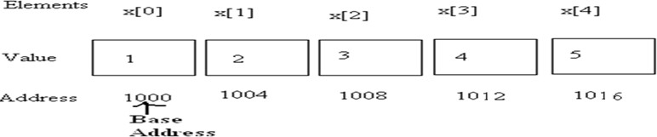
Pointers and Arrays
When an array is declared, the compiler allocates a base address and sufficient amount of storage to contain all the elements of the array in contiguous memory locations.
An array x is declared as follows and assume the base address of x is 1000.
int x[5] ={ 1, 2, 3, 4, 5};
Array x, is a constant pointer, pointing to the first element x[0]. Value of x is 1000 (Base Address), the location of x[0] i.e., is x = &x[0] = 1000

Slide 19
Pointers and Arrays
An integer pointer variable p, can be made to point to an array as follows:
int x[5] = { 1, 2, 3, 4, 5};
int *p;
p =x; OR p =&x[0];
p =&x; //Invalid
Successive array elements can be accessed by writing:
cout<< *p;
p++;
or
cout<< *(p+i); i++;

Slide 20
Pointers and Arrays
Address of an element of x is given by:
Address of x[i] =base address +i *scale factor of (int)
Address of x[3]= 1000 + (3*2) = 1006
The relationship between p and x is shown below. p = &x[0] (=1000)
p + 1 = &x[1] (=1002) p + 2 = &x[2] (=1004) p + 3 = &x[3] (=1006)
p + 4 = &x[4]
*(p+3) is equivalent to x[3].

Slide 21
Example
#include <iostream.h>
void main( )
{
int arr[5] = { 31, 54, 77, 52, 93 };
for(int j=0; j<5; j++) //for each element,
cout << ∗(arr+j); //print value
}
”arr” itself is a constant pointer which can be used to access the elements.

Slide 22
Example
// array accessed with pointer
#include <iostream.h>
void main()
{
int arr[] = { 31, 54, 77, 52, 93 }; //array
int ∗ptr; //pointer to arr
ptr = arr; //points to arr
for(int j=0; j<5; j++) //for each element,
cout << ∗ptr++; //print value
}
”ptr” is a pointer which can be used to access the elements.

Slide 23
Problems
Write a program using pointers to exchange two values (values stored in variables x &y).
Write a program using pointers to find the sum of all elements stored in an integer array.

Slide 24
Pointers and Character Strings
The statement char *cptr = name; declares cptr as a pointer to a character and assigns address of the first character of name as the initial value.
The statement while(*cptr != ‘\0’) is true until the end of the string is reached.
When the while loop is terminated, the pointer cptr holds the address of the null character (‘\0’)
The statement length = cptr – name; gives the length of the string name.
A constant character string always represents a pointer to that string.
The following statements are valid: char *name; name = “Delhi”;

Slide 25
Pointers and 2D Array
int a[][2]={ {12, 22},
{33, 44} };
int (∗p)[2];
p=a; // initialization
Element in 2d represented as
*(*(a+i)+j) or
*(*(p+i)+j)

Slide 26
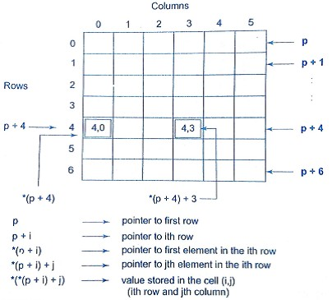
Pointers and 2D Array

Slide 27
Pointers and 2D Array
#include <iostream>
void main()
{
int i, j, (∗p)[2], a[][2]={{12, 22},
{33, 44} };
p=a;
for(i=0;i<2;i++)
{
for(j=0;j<2;j++)
cout<< ∗(∗(p+i)+j)<<“\t”;
cout<<“\n”;
}
}

Slide 28
Array of Pointers
We can use pointers to handle a table of strings.
char name[3][25];
name is a table containing 3 names, each with a maximum length of 25 characters (including ’\0’)
Total storage requirement for name is 75 bytes. But rarely all the individual strings will be equal in lengths.
We can use a pointer to a string of varying length as
char *name[3] = {”New Zealand”, ”Australia”, ”India” };

Slide 29
Array of Pointers
Declares name to be an array of 3 pointers to characters, each pointer pointing to a particular name.
name[0]→ New Zealand name[1]→Australia name[2]→India
This declaration allocates 28 bytes. - Ragged Array
The following statement would print out all the 3 names.
for(i=0; i<=2;i++)
cout<<name[i]; or ∗(name + i);
To access the j^{th} character in the i^{th} name, we may write as
*(name[i] + j)

Slide 30
Pointers and Structures
struct inventory
{
char name[30]; int number; float price;
}product[2], ∗ptr;
ptr=product;
Its members are accessed using the following notation
ptr→name ptr→number
ptr→price

Slide 31
Pointers and Structures
The symbol → is called arrow operator (also known as member selection operator)
The data members can also be accessed using
(*ptr).number
Parentheses is required because ’.’ has higher precedence than the operator *

Slide 32
Function Returning Pointers
int ∗larger (int ∗, int ∗);
void main()
{
int a=10, b=20, ∗p; p=larger (&a, &b); cout<<∗p;
}
int ∗larger (int ∗x, int ∗y)
{
if (∗x > ∗y)
return(x); else
return(y);
}

Slide 33
Dynamic Memory Allocation
Dynamic memory allocation and deallocation is done using two operators: new and delete. An object can be created using new operator and destroyed by delete operator.
A data object created inside a block with new will remain in existence until it is destroyed by using delete
pointer_variable = new data_type;
For example:
p =new int;
q =new float;
Alternatively, int *p =new int; float *q =new float;

Slide 34
Dynamic Memory Allocation
Initializing memory using new:
ptr variable =new datatype(value);
int *p = new int(25);
The constructor will be called implicitly, to initialize the values which are being passed into the object.
To create arrays,
ptr variable = new datatype[size];

Slide 35
Dynamic Memory Allocation
Creating the multidimensional array all the sizes must be supplied. i.e
arrptr = new int[3][4][5]; // Legal
arrptr = new int[m][4]; //Legal
arrptr = new int[][5]; // Illegal
arrptr = new int[4][]; // Illegal
The first dimension may be a variable whose value is supplied at runtime, whereas the others must a constant.

Slide 36
Dynamic Memory de-allocation
Syntax
delete p;
storage pointed to by p is returned to free store and p is now undefined
Example: int* p = new int;
*p = 10;
delete p;

Slide 37
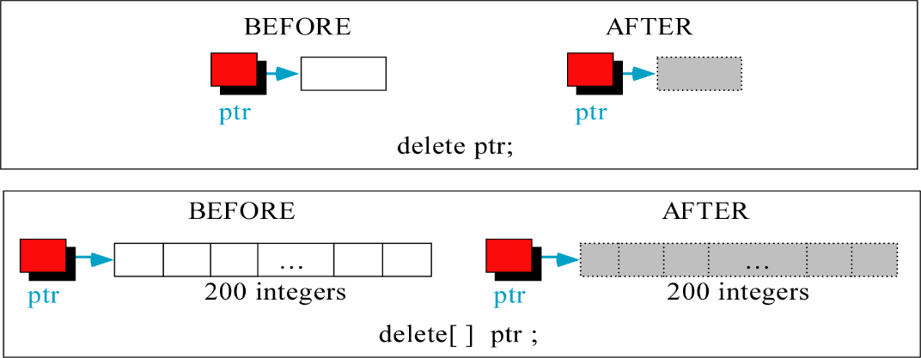
Dynamic Memory de-allocation
If not taken care properly, it my result in:
Dangling pointer problem
Memory Leak problem

